Slide 1
COLLECTION FRAMEWORK

Slide 2
INTRODUCTION
Collection: A Collection represents a single unit of objects, i.e., a group.
Framework: It represents a set of classes and interfaces.
Collection framework:
The Collection framework represents a unified architecture for storing and manipulating a group of objects. It has:
Interfaces and its implementations, i.e., classes
Algorithm
Java Collections can achieve all the operations that you perform on a data such as searching, sorting, insertion, manipulation, and deletion.

Slide 3
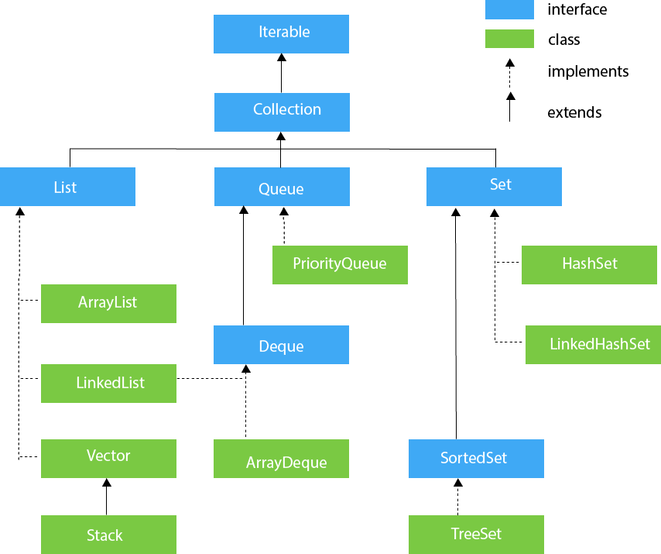
Hierarchy of Collection Framework

Slide 4
INTERFACES OF COLLECTION FRAMEWORK
There are 9 main interfaces in collection framework:
1. Collection
2. List
3. Set
4. SortedSet
5. NavigableSet
6. Queue
7. Map
8. SortedMap
9. NavigableMap

Slide 5
COLLECTION (I)
Collection interface is used to represent group of individual objects as a single entity
Collection is the root interface of the collection framework
It defines the common methods applicable to any collection objects
s2
s1
s3
s4
s5

Slide 6
COLLECTION- Methods
boolean add(Object o): used to insert an element in this collection
boolean addAll(Collection c): used to insert the specified collection elements in the invoking collection
boolean remove(Object o): used to delete an element from the collection
boolean removeAll(Collection c): is used to delete all the elements of the specified collection from the invoking collection
boolean retainAll(Collection c): used to delete all the elements of invoking collection except the specified collection

Slide 7
COLLECTION- Methods (cont…)
void clear( ): It removes the total number of elements from the collection
boolean contains(Object o): used to search an element
boolean containsAll(Collection c): used to search the specified collection in the collection
boolean isEmpty( ): It checks if collection is empty
int size( ): It returns the total number of elements in the collection
Object [ ] toArray( ): It converts collection into array
Iterator iterator( ): It returns an iterator

Slide 8
Set Interface

Slide 9
Set Interface
Set Interface in Java is present in java.util package.
It extends the Collection interface.
It represents the unordered set of elements which doesn't allow us to store the duplicate items.
We can store at most one null value in Set.
Set is implemented by HashSet, LinkedHashSet, and TreeSet.

Slide 10
Java HashSet
Java HashSet class is used to create a collection that uses a hash table for storage.
It inherits the AbstractSet class and implements Set interface.
HashSet stores the elements by using a mechanism called hashing.
HashSet contains unique elements only.
HashSet allows null value.
HashSet class is non synchronized.
HashSet doesn't maintain the insertion order. Here, elements are inserted on the basis of their hashcode.
HashSet is the best approach for search operations.
The initial default capacity of HashSet is 16, and the load factor is 0.75.

Slide 11
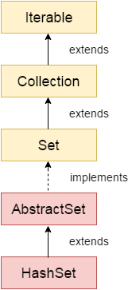
Hierarchy of HashSet class

Slide 12
Java LinkedHashSet class
Java LinkedHashSet class is a HashSet and Linked list implementation of the set interface.
It inherits HashSet class and implements Set interface.
Java LinkedHashSet class contains unique elements only like HashSet.
Java LinkedHashSet class provides all optional set operation and permits null elements.
Java LinkedHashSet class is non synchronized.
Java LinkedHashSet class maintains insertion order.

Slide 13
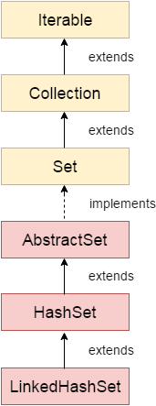
Hierarchy of LinkedHashSet class

Slide 14
Java TreeSet class
Java TreeSet class implements the Set interface that uses a tree for storage.
The objects of the TreeSet class are stored in ascending order.
Java TreeSet class contains unique elements only like HashSet.
Java TreeSet class access and retrieval times are quiet fast.
Java TreeSet class doesn't allow null element.
Java TreeSet class is non synchronized.
Java TreeSet class maintains ascending order.

Slide 15
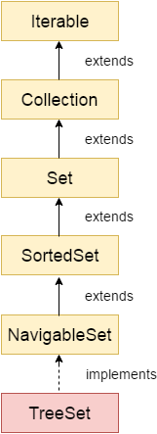
Hierarchy of TreeSet class

Slide 16
List Interface

Slide 17
ArrayList Class
Java ArrayList class uses a dynamic array for storing the elements.
It is like an array, but there is no size limit. We can add or remove elements anytime.
So, it is much more flexible than the traditional array.
It is found in the java.util package.
The ArrayList in Java can have the duplicate elements also.
It implements the List interface so we can use all the methods of List interface here.
It inherits the AbstractList class and implements List interface.

Slide 18
The ArrayList maintains the insertion order internally.
Java ArrayList class is non synchronized.
Java ArrayList allows random access because array works at the index basis.
In ArrayList, manipulation is little bit slower than the LinkedList in Java because a lot of shifting needs to occur if any element is removed from the array list.

Slide 19
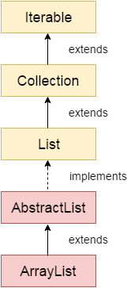
Hierarchy of ArrayList class

Slide 20
LinkedList class
Java LinkedList class uses a doubly linked list to store the elements.
It provides a linked-list data structure.
It inherits the AbstractList class and implements List and Deque interfaces.
Java LinkedList class can contain duplicate elements.
Java LinkedList class maintains insertion order.
Java LinkedList class is non synchronized.
In Java LinkedList class, manipulation is fast because no shifting needs to occur.
Java LinkedList class can be used as a list, stack or queue.

Slide 21
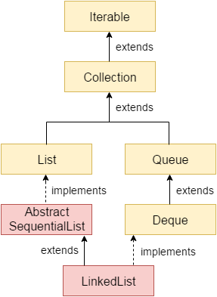
Hierarchy of LinkedList class

Slide 22
Difference between ArrayList and LinkedList
ArrayList | LinkedList
1) ArrayList internally uses a dynamic array to store the elements. | LinkedList internally uses a doubly linked list to store the elements.
2) Manipulation with ArrayList is slow because it internally uses an array. If any element is removed from the array, all the bits are shifted in memory. | Manipulation with LinkedList is faster than ArrayList because it uses a doubly linked list, so no bit shifting is required in memory.
3) An ArrayList class can act as a list only because it implements List only. | LinkedList class can act as a list and queue both because it implements List and Deque interfaces.
4) ArrayList is better for storing and accessing data. | LinkedList is better for manipulating data.

Slide 23
Sorting in Collection
We can sort the elements of:
String objects
Wrapper class objects
User-defined class objects
Method of Collections class for sorting List elements
public void sort(List list): is used to sort the elements of List. List elements must be of the Comparable type.

Slide 24
Java Comparable interface
Java Comparable interface is used to order the objects of the user-defined class.
This interface is found in java.lang package and contains only one method named compareTo(Object).
It provides a single sorting sequence only, i.e., you can sort the elements on the basis of single data member only.
For example, it may be rollno, name, age or anything else.

Slide 25
compareTo(Object obj) method
public int compareTo(Object obj): It is used to compare the current object with the specified object. It returns
positive integer, if the current object is greater than the specified object.
negative integer, if the current object is less than the specified object.
zero, if the current object is equal to the specified object.

Slide 26
Java Comparator interface
Java Comparator interface is used to order the objects of a user-defined class.
This interface is found in java.util package and contains 2 methods:
compare(Object obj1,Object obj2)
equals(Object element).
It provides multiple sorting sequences, i.e., we can sort the elements on the basis of any data member, for example, rollno, name, age or anything else.

Slide 27
Method of Collections class for sorting List elements
public void sort(List list, Comparator c): is used to sort the elements of List by the given Comparator.

Slide 28
Queue Interface

Slide 29
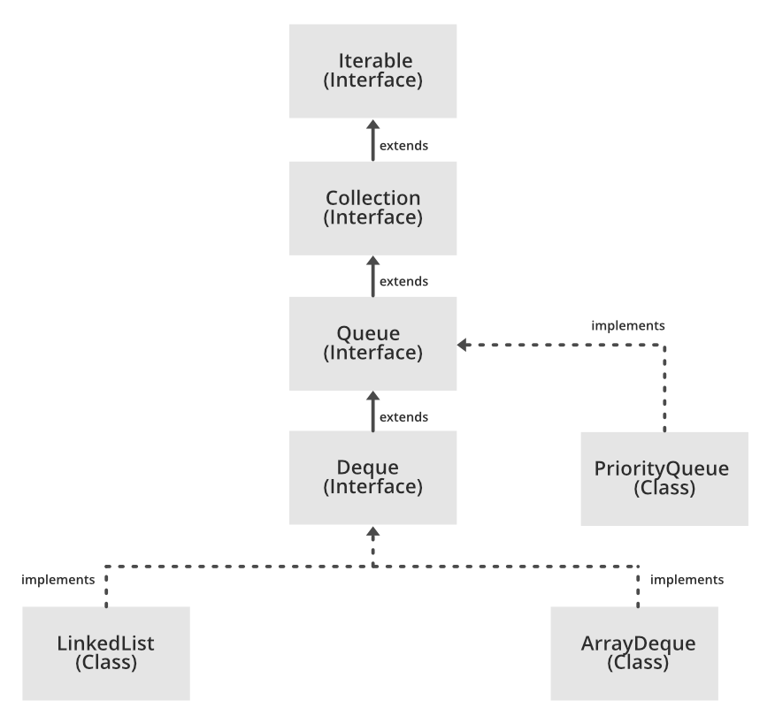
Java Queue Interface
Java Queue interface orders the element in FIFO(First In First Out) manner.
In FIFO, first element is removed first and last element is removed at last.

Slide 30
Methods of Java Queue Interface
Method | Description
boolean add(object) | It is used to insert the specified element into this queue and return true upon success.
boolean offer(object) | It is used to insert the specified element into this queue.
Object remove() | It is used to retrieves and removes the head of this queue.
Object poll() | It is used to retrieves and removes the head of this queue, or returns null if this queue is empty.
Object element() | It is used to retrieves, but does not remove, the head of this queue.
Object peek() | It is used to retrieves, but does not remove, the head of this queue, or returns null if this queue is empty.

Slide 31
PriorityQueue class
The PriorityQueue class provides the facility of using queue.
But it does not orders the elements in FIFO manner. It inherits AbstractQueue class.

Slide 32
Java Deque Interface
Java Deque Interface is a linear collection that supports element insertion and removal at both ends.
Deque is an acronym for "double ended queue".

Slide 33
Deque methods
public abstract void addFirst(E);
public abstract void addLast(E);
public abstract boolean offerFirst(E);
public abstract boolean offerLast(E);
public abstract E removeFirst();
public abstract E removeLast();
public abstract E pollFirst();
public abstract E pollLast();
public abstract E getFirst();
public abstract E getLast();
public abstract E peekFirst();
public abstract E peekLast();

Slide 34
ArrayDeque class
The ArrayDeque class provides the facility of using deque and resizable-array.
It inherits AbstractCollection class and implements the Deque interface.
Unlike Queue, we can add or remove elements from both sides.
Null elements are not allowed in the ArrayDeque.
ArrayDeque is not thread safe, in the absence of external synchronization.
ArrayDeque has no capacity restrictions.
ArrayDeque is faster than LinkedList and Stack.

Slide 35
Map Interface

Slide 36
Java Map Interface
A map contains values on the basis of key, i.e. key and value pair. Each key and value pair is known as an entry.
A Map contains unique keys.
A Map is useful if you have to search, update or delete elements on the basis of a key.
A Map doesn't allow duplicate keys, but you can have duplicate values.
A Map can't be traversed, so you need to convert it into Set using keySet() or entrySet() method.
Entry interface in Java provides certain methods to access the entry in the Map. By gaining access to the entry of the Map we can easily manipulate them.
Map.Entry is a generic and is defined in the java.
The Map.Entry interface contains the getKey() and getValue() methods.

Slide 37
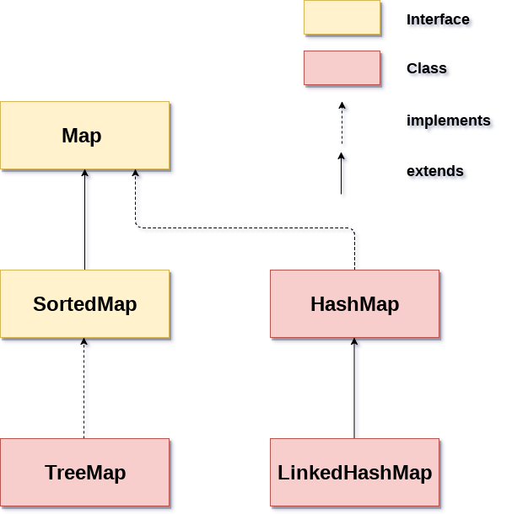
Java Map Hierarchy
There are two interfaces for implementing Map in java: Map and SortedMap, and three classes: HashMap, LinkedHashMap, and TreeMap.

Slide 38
Hash map
Java HashMap class implements the Map interface which allows us to store key and value pair, where keys should be unique.
HashMap in Java is like the legacy Hashtable class, but HashMap is not synchronized.
It allows us to store the null elements as well, but there should be only one null key and multiple null values.
Since Java 5, it is denoted as HashMap<K,V>, where K stands for key and V for value.
Java HashMap maintains no order.
The initial default capacity of Java HashMap class is 16 with a load factor of 0.75.

Slide 39
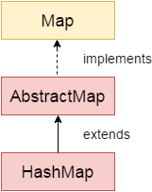
HashMap Hierarchy
It inherits the AbstractMap class and implements the Map interface.

Slide 40
Constructors of Java HashMap class
Constructor | Description
HashMap() | It is used to construct a default HashMap.
HashMap(Map<? extends K,? extends V> m) | It is used to initialize the hash map by using the elements of the given Map object m.
HashMap(int capacity) | It is used to initializes the capacity of the hash map to the given integer value, capacity.
HashMap(int capacity, float loadFactor) | It is used to initialize both the capacity and load factor of the hash map by using its arguments.

Slide 41
Method of HashMap
void clear() | It is used to remove all of the mappings from this map.
boolean isEmpty() | It is used to return true if this map contains no key-value mappings.
Object clone() | It is used to return a shallow copy of this HashMap instance: the keys and values themselves are not cloned.
Set entrySet() | It is used to return a collection view of the mappings contained in this map.
Set keySet() | It is used to return a set view of the keys contained in this map.
V put(Object key, Object value) | It is used to insert an entry in the map.
void putAll(Map map) | It is used to insert the specified map in the map.
V putIfAbsent(K key, V value) | It inserts the specified value with the specified key in the map only if it is not already specified.
V remove(Object key) | It is used to delete an entry for the specified key.
boolean remove(Object key, Object value) | It removes the specified values with the associated specified keys from the map.

Slide 42
Contd…
V get(Object key) | This method returns the object that contains the value associated with the key.
V getOrDefault(Object key, V defaultValue) | It returns the value to which the specified key is mapped, or defaultValue if the map contains no mapping for the key.
V merge(K key, V value, BiFunction<? super V,? super V,? extends V> remappingFunction) | If the specified key is not already associated with a value or is associated with null, associates it with the given non-null value.
V replace(K key, V value) | It replaces the specified value for a specified key.
boolean replace(K key, V oldValue, V newValue) | It replaces the old value with the new value for a specified key.
void replaceAll(BiFunction<? super K,? super V,? extends V> function) | It replaces each entry's value with the result of invoking the given function on that entry until all entries have been processed or the function throws an exception.
Collection<V> values() | It returns a collection view of the values contained in the map

Slide 43
LinkedHashMap
Java LinkedHashMap class is Hashtable and Linked list implementation of the Map interface, with predictable iteration order.
Java LinkedHashMap contains values based on the key.
Java LinkedHashMap contains unique elements.
Java LinkedHashMap may have one null key and multiple null values.
Java LinkedHashMap is non synchronized.
Java LinkedHashMap maintains insertion order.

Slide 44
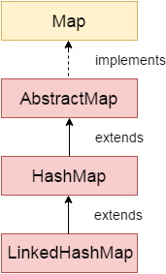
LinkedHashMap Hierarchy
LinkedHashMap inherits HashMap class and implements the Map interface.

Slide 45
TreeMap
Java TreeMap class is a red-black tree based implementation.
It provides an efficient means of storing key-value pairs in sorted order.
Java TreeMap contains values based on the key.
Java TreeMap contains only unique elements.
Java TreeMap cannot have a null key but can have multiple null values.
Java TreeMap is non synchronized.
Java TreeMap maintains ascending order.

Slide 46
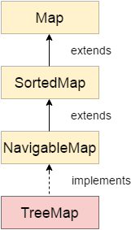
TreeMap Hierarchy
TreeMap implements the NavigableMap interface and extends AbstractMap class.

Slide 47
Legacy Classes

Slide 48
Legacy Class in Java
In the early version of Java, we have several classes and interfaces which allow us to store objects.
After adding the Collection framework in JSE 1.2, for supporting the collections framework, these classes were re-engineered.
So, classes and interfaces that formed the collections framework in the older version of Java are known as Legacy classes.
All the legacy classes are synchronized.

Slide 49
List of Legacy Classes
The java.util package defines the following legacy classes:
Vector
Stack
Dictionary
HashTable
Properties

Slide 50
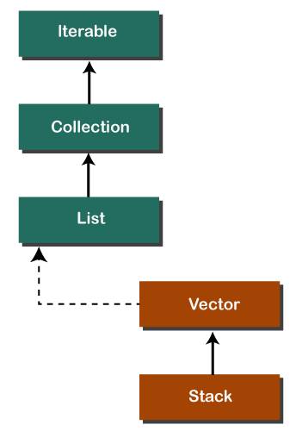
Vector & Stack in Collections framework hierarchy

Slide 51
Vector Class
Vector is a special type of ArrayList that defines a dynamic array.
ArrayList is not synchronized while vector is synchronized.
Vector having default initial size of 10.
Constructors of Vectors:
Vector()
Vector(int size)
Vector(int size, int incr)
Vector(Collection c)

Slide 52
Stack Class
Stack class extends Vector class, which follows the LIFO.
Constructor of Stack:
Stack()
Methods of Stack:
Method | Modifier and Type | Method Description
empty() | boolean | The method checks the stack is empty or not.
push(E item) | E | The method pushes (insert) an element onto the top of the stack.
pop() | E | The method removes an element from the top of the stack and returns the same element as the value of that function.
peek() | E | The method looks at the top element of the stack without removing it.
search(Object o) | int | The method searches the specified object and returns the position of the object.

Slide 53
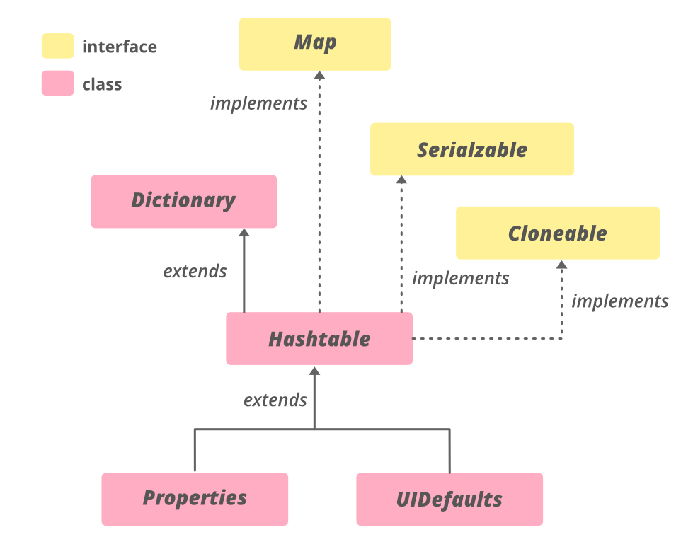
Dictionary Class
The Dictionary class operates much like Map and represents the key/value storage repository.
The Dictionary class is an abstract class that stores the data into the key/value pair.

Slide 54
Dictionary Class Methods
The put(K key, V value) method is used to add a key-value pair to the dictionary.
The elements() method is used to get the value representation in the dictionary.
The get(Object key) method is used to get the value mapped with the argumented key in the dictionary.
The isEmpty() method is used to check whether the dictionary is empty or not.
The keys() method is used to get the key representation in the dictionary.
The remove(Object key) method removes the data from the dictionary.
The size() method is used to get the size of the dictionary.

Slide 55
Hashtable Class
The Hashtable class is similar to HashMap. It also contains the data into key/value pairs.
HashTable having default size 11.
Hashtable constructors:
1) Hashtable()
2) Hashtable(int size)
3) Hashtable(int size, float fillratio)
The fillratio must be between 0.0 and 1.0.
4) Hashtable(Map< ? extends K, ? extends V> m)

Slide 56
Properties Class
Properties class extends Hashtable class to maintain the list of values.
The list has both the key and the value of type string.
Constructors of Properties Class:
Method | Description
Properties() | It creates an empty property list with no default values.
Properties(Properties defaults) | It creates an empty property list with the specified defaults.

Slide 57
Java Arrays Class

Slide 58
Arrays
The Arrays class in java.util package is a part of the Java Collection Framework.
This class provides static methods to dynamically create and access Java arrays. It consists of only static methods and the methods of Object class.
The methods of this class can be used by the class name itself.
Class Hierarchy:
java.lang.Object
↳ java.util.Arrays

Slide 59
Need for the Java-Arrays Class:
There are often times when loops are used to do some tasks on an array like:
Fill an array with a particular value.
Sort an Arrays.
Search in an Arrays.
And many more.
Arrays class provides several static methods that can be used to perform these tasks directly without the use of loops.

Slide 60
Methods in Java Array
Arrays.asList(): This method returns a fixed-size list backed by the specified Arrays.
The original array and created array backed List are linked. When a change is made to one, it is available in the other.
It is a fixed-size list and is also known a backed List because the array changes with it.
Arrays.sort(): This method sorts the complete array in ascending order.

Slide 61
Arrays.binarySearch(): These methods searches for the specified element in the array with the help of Binary Search algorithm.
Arrays.toString(): This method returns a String representation of the contents of this Arrays.
Arrays.copyOf(): This method copies the specified array, truncating or padding with the default value (if necessary) so the copy has the specified length.
Arrays.equals(): This method checks if both the arrays are equal or not.
Arrays.fill(): This method assigns this fillValue to each index of this Arrays.

Slide 62
Utility Classes

Slide 63
More Utility classes
StringTokenizer
BitSet
Date
Calendar
Random
Formatter
Scanner

Slide 64
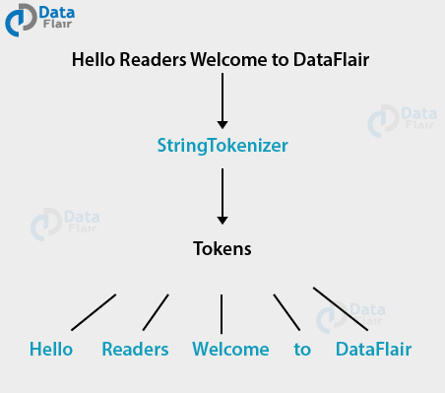
StringTokenizer
StringTokenizer class is used for creating tokens in Java.
It allows an application to break or split into small parts.
Each split string part is called Token.

Slide 65
StringTokenizer Constructors
There are 3 types of Constructors available in Java StringTokenizer:
Constructor | Description
StringTokenizer(String str) | creates StringTokenizer with specified string.
StringTokenizer(String str, String delim) | creates StringTokenizer with specified string and delimeter.
StringTokenizer(String str, String delim, boolean returnValue) | creates StringTokenizer with specified string, delimeter and returnValue. If return value is true, delimiter characters are considered to be tokens. If it is false, delimiter characters serve to separate tokens.

Slide 66
StringTokenizer Methods
Following are 5 types of Methods available in Java StringTokenizer:
public boolean hasMoreTokens()
public String nextToken()
public int countTokens()
public Object nextElement()
public boolean hasMoreElements()

Slide 67
BitSet
BitSet creates an array of bits represented by boolean values.
The size of the array is flexible and can grow to accommodate additional bit as needed.
As it is an array, the index is zero-based and the bit values can be accessed only by non-negative integers as an index .
BitSet class Constructors:
BitSet()
BitSet(int nBits)

Slide 68
BitSet Methods
void set(int index)
void set(int index, boolean v)
void set(int startIndex, int endIndex)
boolean get(int index)
boolean isEmpty( )
int size( )
int length( )
void clear( )
void and(BitSet bitSet)
void or(BitSet bitSet)
void xor(BitSet bitSet)

Slide 69
Random class
Random class is used to generate a stream of pseudorandom numbers.
Constructor:
Random(): This creates a new random number generator.

Slide 70
Random Class methods
next() | Generates the next pseudorandom number.
nextBoolean() | Returns the next uniformly distributed pseudorandom boolean value from the random number generator's sequence
nextByte() | Generates random bytes and puts them into a specified byte array.
nextDouble() | Returns the next pseudorandom Double value between 0.0 and 1.0 from the random number generator's sequence
nextFloat() | Returns the next uniformly distributed pseudorandom Float value between 0.0 and 1.0 from this random number generator's sequence
nextInt() | Returns a uniformly distributed pseudorandom int value generated from this random number generator's sequence
nextLong() | Returns the next uniformly distributed pseudorandom long value from the random number generator's sequence.
nextBytes(byte[] bytes) | Generates random bytes and places them into a user-supplied byte array

Slide 71
Date class
The class Date represents a specific instant in time, with millisecond precision.
The Date class of java.util package implements Serializable, Cloneable and Comparable interface.
It provides constructors and methods to deal with date and time with java.
long getTime() : Returns the number of milliseconds since January 1, 1970, 00:00:00 GMT represented by this Date object.

Slide 72
Calendar class
Java Calendar class is an abstract class that provides methods for converting date between a specific instant in time and a set of calendar fields such as MONTH, YEAR, HOUR, etc.
It inherits Object class and implements the Comparable interface.
public static Calendar getInstance(): This method is used with calendar object to get the instance of calendar according to current time zone set by java runtime environment

Slide 73
Formatter class
The Formatter is a built-in class in java used for layout justification and alignment, common formats for numeric, string, and date/time data, and locale-specific output in java programming.
The Formatter class is defined as final class inside the java.util package.

Slide 74
Scanner Class
Scanner class in Java is found in the java.util package. Java provides various ways to read input from the keyboard, the java.util.Scanner class is one of them.
The Java Scanner class is widely used to parse text for strings and primitive types using a regular expression.
It is the simplest way to get input in Java. By the help of Scanner in Java, we can get input from the user in primitive types such as int, long, double, byte, float, short, etc.
The Java Scanner class extends Object class and implements Iterator and Closeable interfaces.

Slide 75
The Java Scanner class provides nextXXX() methods to return the type of value such as:
nextInt(), nextByte(), nextShort(), next(), nextLine(), nextDouble(), nextFloat(), nextBoolean(), etc.
To get a single character from the scanner, we can call next().charAt(0) method which returns a single character.

